Slide 1
SWISL Soccer Ref Clinic
By Chelsey Buman

Slide 2
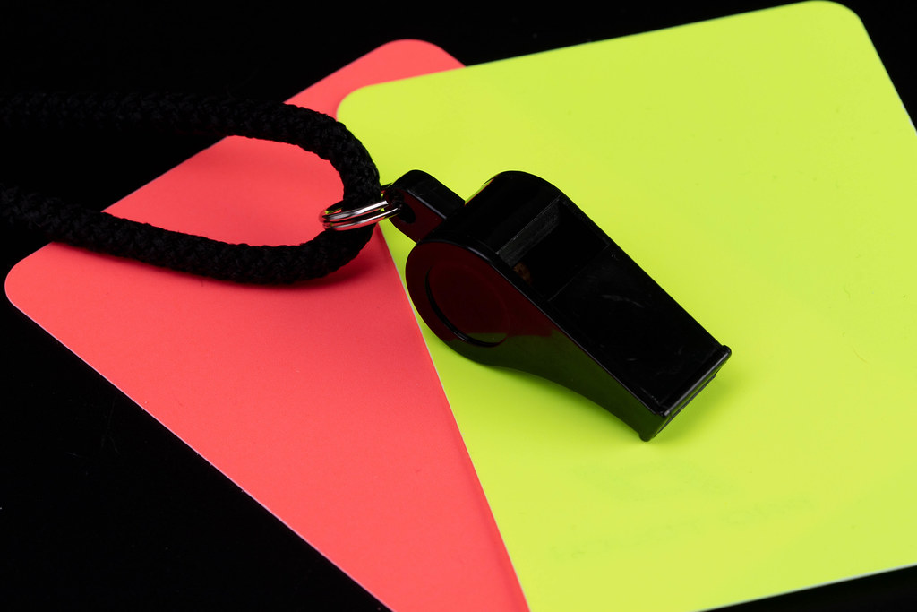
Ref requirements and Uniforms
Uniform attire
Equipment for refereeing
Refs are required to do check in
Roster check are a MUST!
Arrival and game start
This Photo by Unknown Author is licensed under CC BY
Notes:
1)All refs are required to wear athletic attire. Shorts/sweatpants. Tennis shoes or cleats. A green ref shirt or the OG pink ref shirts. (If refs want a pink ref shirt they are now $12.00)
2)Refs will receive a whistle, that they keep. AR flags, a green ref shirt, and ref cards/booklet. Which are returned at the end of the season to me.
3)Beginning game check in IS required. Please check shin guards, cleats, for jewelry, and uniforms. Please do a roster check at this time. Remind kids of rules specific to the division you are reefing. example. U10 can not use headers
4) Because of the borrowed players rule roster checks must be done! You can call either first names or last names. Check numbers. And mark borrowed players if any on your sheets.
5) Games need to be started on TIME due to the scheduling! Please arrive with plenty of time to do the ref check at the beginning of the games

Slide 3
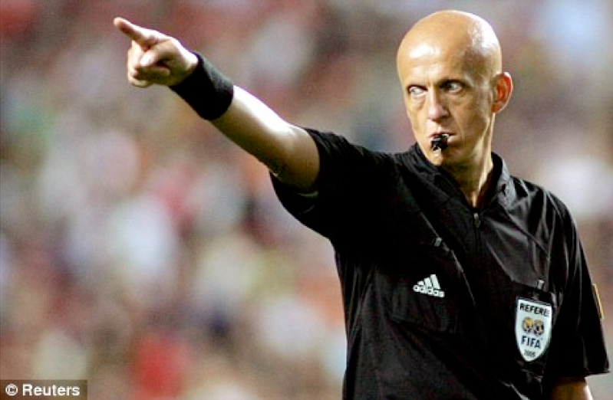
Game Time Beginning, Middle, End
Games starts
Half time!
The End
Added time?
NO Time outs
Substitution
Player count
Injuries
Show me the card
This Photo by Unknown Author is licensed under CC BY-NC-ND
Notes:
Game starts with captians, a coin flip or guess a number to see who starts the game. U8 and U10 the ball must progress forward on the start. U12 and U15 the ball can progress forward or reseed behind the half. The player that touches the ball may only do it once!
Half times should be 5 mins for u8, u10, and u12 UNLESS the team is playing short or at playing field then it extend it to 10. U15 have a 10 min half. Teams need to swap sides during half time.
The game ends when the clock ends. PERIOD! If the game ends in a tie, as long as both teams agree you may do 1 round of a 5v5 shoot out. Due to time we will not do more than 1 round.
Added time can be done per half or at the end of the game. This time is when you have an injury on the field, when a player has to go “hunting” for the ball, or if the ref stops the game for any reason. Please communicate the time with your AR.
There is NO such thing as a time out in soccer. DO NOT LET COACHES TELL YOU OTHERWISE!
There is no added time for subbing. All teams/ divisions can free sub except U15 they sub on procession. Subbing can only be done on a dead ball or an injury! Subbing needs to be done at the half. If a player enters your field with out the refs permission it is a yellow card. Do not give cards for this in U8 they are 6 and 7yrs old. Give warnings in u10 and u12 before carding. You may card right away in u15.
When there is a substitution, at the beginning of the game, and beginning of the half a ref should always count the numbers of players on the field!
If an injury occurs and the player goes to the ground the game stops immediately! Time will be added for the injury and a substitution must be made for the injured player.
Yellow cards serve as cautions reds are full stops. If a yellow card is awarded the player must leave the field for 5 mins, a substitution may be made. A red card means the player leaves the field for the remainder of the game and also sits the following game. This goes for coaches as well. If a Red card is giving you must call me after the game finishes and before the next game begins!

Slide 4
It is Your game to control
The ref’s word is Law
The field is your safe zone
Youth Refs
Whistle
1 whistle to start play and stop play
2 long whistles to end the half
3 long whistles to end the game
Call it how you see it
Teamwork makes the dream work
Notes:
On the field your word is absolute. If you didn’t see a call then it didn’t happen. We are all human and miss stuff, do not call something you didn’t see. SWISL rules do differ from other leagues so please read the SWISL Laws of the game. Cards can be issued to coaches and players who argue with referees.
Parents have no say in the way the game is run. If there is a rowdy parent you have every right to eject them. If this is done you need to contact me immediately! The Game must stop and either myself or the town director must be informed. DO NOT take on an angry parent, this is why the directors and my self are here. Stay in the middle of the field and make the call. This can also be done with coaches.
It is verbal abuse to yell at a youth ref. if you see this being done or have this done call myself immediately! Youth refs should not take on adults. The SWISL league does not tolerate parents yelling at our youth refs
USE YOUR WHISTLE. U8 kids will not stop playing unless you use your whistle. To start and stop games refs need to blow their whistle and blow it loud!
We are human and make mistake call the game to the best of your ability. Do not be afraid to blow the whistle but do over blow it. There are certain fouls that can be playable.
Most games except U8 you will be run in a pair. WORK together! Do not contradict each other! This is a team ordeal not a center and a AR. It is also better to tag team any issue not solo it.

Slide 5
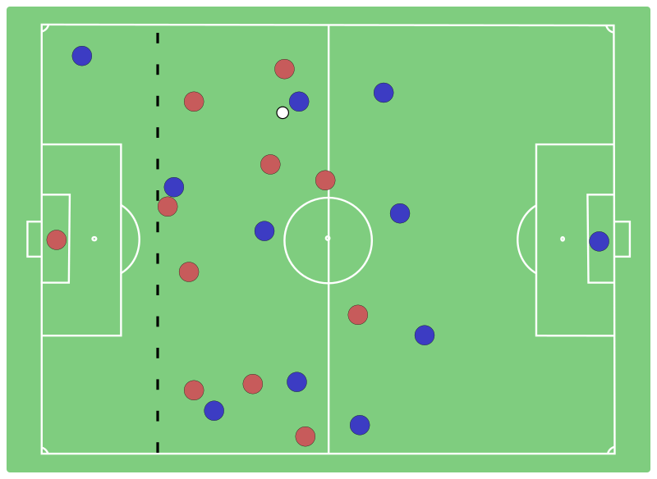
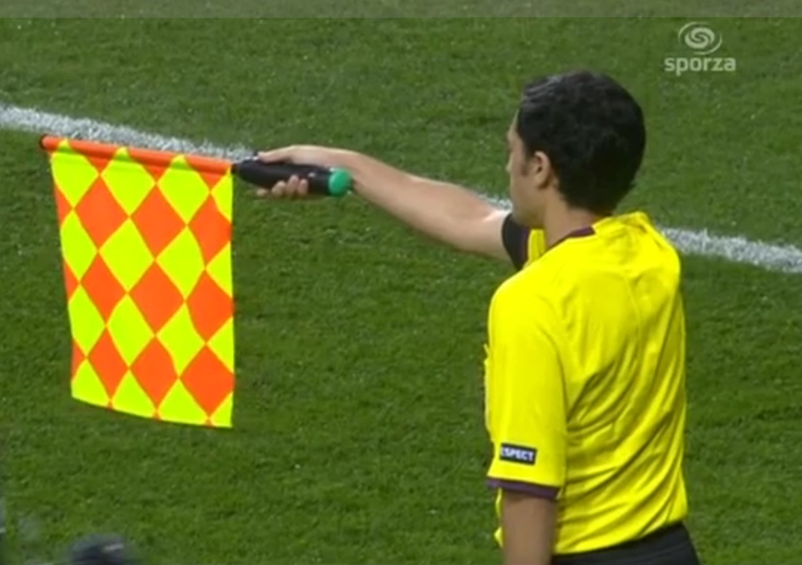
Offsides
This Photo by Unknown Author is licensed under CC BY-SA
This Photo by Unknown Author is licensed under CC BY-NC-ND
Offsides occurs when the attacker is closer to the goal than the last defender or the ball.
Offsides in U15
AR and offsides
Notes:
Offsides occurs when the attacker is closer to the goal than the last defender or the ball. This is in age division u10, u12, and u15. see image
u15 also has the over and back rule where if an attack is offside and comes back onsides they cannot be directly involved with the play once back onsides.
The Ars main job is to watch for offside! Once they see it then need to snap their flag and hold it straight out to indicate where offsides occurred.

Slide 6
Let’s start with the Monster division... U8
Game duration
U8 plays 5v5 with a size 3 ball
Throw ins
Corners and goal kicks
No keepers
U8 are their own breed
Notes:
U8 games are 40mins long, 2 20 mins halves, half times need to be 5 mins or 10 if they are playing at field
U8 kids play 5v5 with a size 3 ball
Throw ins are done when the ball completely crosses the sidelines. Players must throw the ball starting from completely behind the head and having 1 foot fully in contact with the ground and the other can just be touching while the ball leaves their hands. The key is that 1 foot must be planted on the ground! U8 gets 2 attempts per player
U8 do corner and goal kicks there is no offside in u8
Because there is no keep, there is still a penalty area, this area is used like the paint in basketball. Players may enter and go through this card, however they can not sit in this area. Remind players and coaches of this during check in. If you have to constantly remind a player of this law, you can award a yellow card and a free indirect kick can be awarded. This is also where goal kicks take place.
With fouls be lenient, these kids are learning try to explain what they did wrong. Watch pushing and tripping with this age division. All fouls are indirect kicks which means the ball MUST touch someone before it can go in the goal. ALWAYS use your whistle! U8 do not listen to you otherwise. Do not be afraid to do a drop ball if the foul was unintentional such as hand balls. For this age they are just really learning the rules.

Slide 7
Questions for U8?

Slide 8
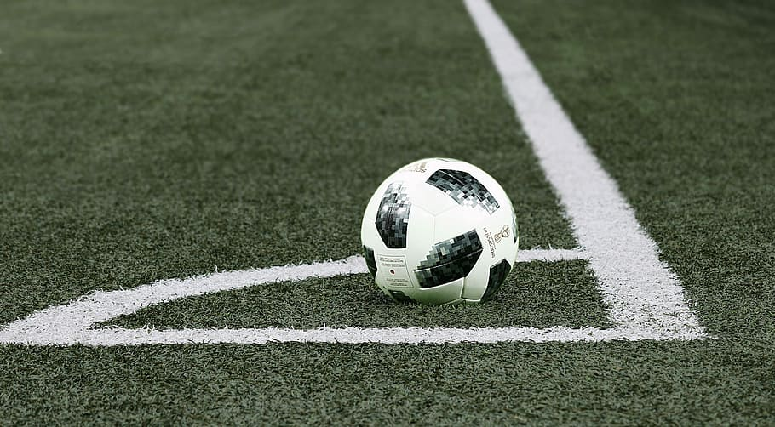
The “know it all” division... U10
Game duration
U10 plays 9v9 with a size 4 ball
Throw ins
Intro to Keeper
Slide tackling but no headers?
Offsides
Breaking the bad habits
Notes:
1) U10 plays 50 min games or 2 25 min halves. Teams switch sides at half.
2) U10 plays 9v9 with a size 4 ball
3) Throw ins, by this age they should know how to do a throw in. They get 1 extra attempt per player.
4) Remind keepers to call for the ball when going to the ground during the check in. Being a keeper is not an easy position. When the keeper is going down for the ball and their hands are almost around it call the other players off. We do not need anyone getting hurt. Pass back to the keeper law has changed! It is no longer a PK it is an indirect kick from the spot of the foul.
5) u10 can slide tackle but they can not do headers. Slide tackling needs to be done correctly! Kicking the ball while on the ground is NOT a slide tackle. Slide tackling needs to be from the side or the front and the player must touch the ball first! Accidental headers happen which is an indirect kick. If it is intentional, it is a direct kick. Headers are not allowed because this age group does them incorrectly more then correctly.
6) u10 is the into to offsides they may need a little explaining at the game check in
7) Laws are laws for a reason this is the age group where we enforce them. Explain where they went wrong but call more than what you would in u8 direct kicks come into play at this age group. Fouls need to be called. The more we call the more we can nip the bad habits in the butt. This is the age where they think they know it all and will complain about everything.

Slide 9
Questions for U10?

Slide 10
U12 the been there done that division
Game duration
9v9 with a size 4 ball
Throw ins
Offsides, keepers, and starts oh my!
Indirect or direct kick
PK where’s the line?
This Photo by Unknown Author is licensed under CC BY-NC
Notes:
Game duration for u12 is 60 mins or 2 30 min halves
U12 plays 9v9 with a size 4 ball
U12 gets 1 rethrow per team per half by this age they should know how to do a proper throw in
Offsides is going to be called more at this age, keepers do not need to be guarded as much as before, and the ball may proceed forward or reseed behind half at this age.
Indirect kicks should be done when a foul is committed by accident, direct kicks are giving when the foul is considered aggressive or dangerous. Handballs ARE direct kicks!
Any foul committed inside the penalty area is a PK. The player must be completely inside the penalty area when the foul is committed to be called a PK.

Slide 11
Questions for U12

Slide 12
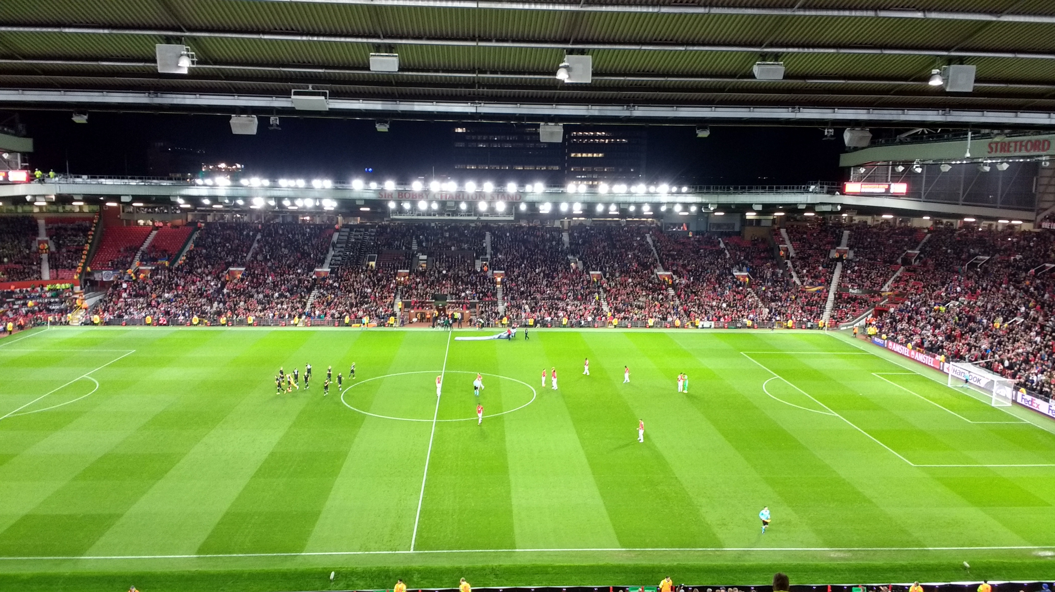
U15 Welcome to the big leagues!
Game duration
11v11 with a size 5 ball
Substitutions
Push the laws
Cards galore!
Offsides with no mercy
You call that a throw in?
Be in control but don’t forget to have fun!
Notes:
U15 plays a 70 min game or 2 35 min halves
They play 11v11 with a size 5 ball and 10 min halves
Substitutions can be done only on possession or if both teams have a sub at half. If a player enters the field with out the refs consent it is a yellow card!
Do not let this age group get away with anything by this age they should know the laws call it all! There will be 3 refs on each u15 game!
Do not be afraid to throw a yellow at this age group! We are prepping them for high school soccer.
This age group plays offside to the limit. Over and back is a for sure thing at this age.
Call the bad throw ins! There is NO retry at this age! It automictically goes to the opponent.
Most of these players have been playing since they were U10 in this league maintain control but don’t forget to have fun. If you have been refereeing for me for awhile these kids have seen you ref before. Don’t forget to praise the good and scold the bad. You are their guide not a field dictator. This is the age group where you can have fun don’t forget to joke with them, they will appreciate it.

Slide 13
U15 questions?

Slide 14
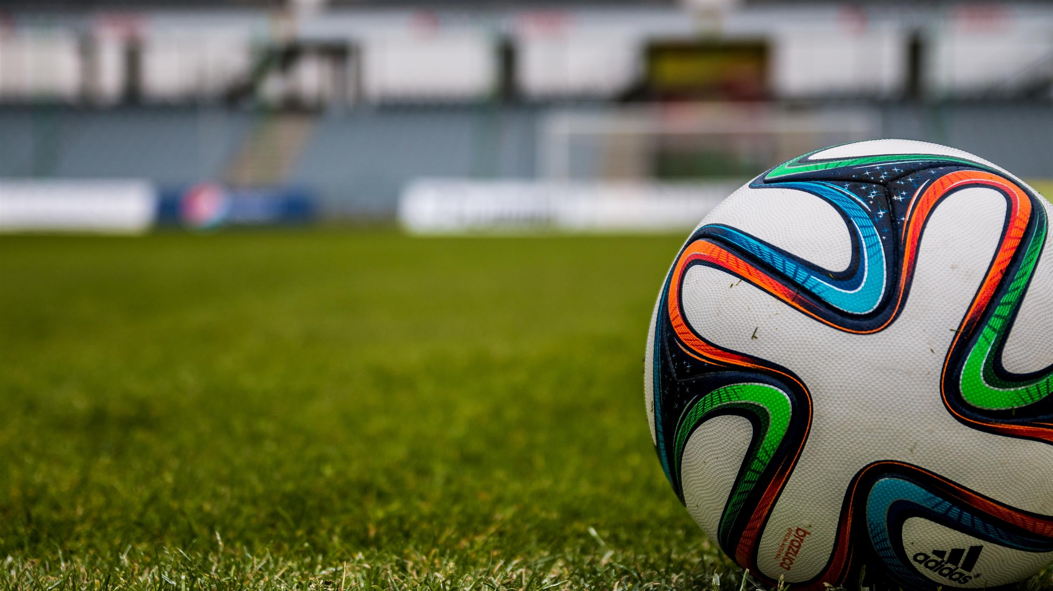
Scheduling and Communications
Please join the team reach group SWISLREFS1 on the team reach app
All refs must watch this slide show before they can ref!
Chelsey Buman 641-420-8891 swiowaayso451@gmail.com
Ref Pay and by whom: Chelsey AYSO RC/SWISL Ref “person”, Mark- SWISL President, or Ashley Avoca Board member/ SWISL Treasure
Scheduling
April 12th
May 9th and 10th
Week 1 April 5th Atlantic and Griswold
Notes:
Because there are so many of you this is how I will be communicating from here on out. If someone is not in there that you know questions, please add them.
Since we did not do an inperson meeting everyone must watch this slideshow. Sorry if it is boring. If you have additional questions you can either txt me or email them to me
Chelsey Buman 641-420-8891 swiowaayso451@gmail.com
All refs are paid $20 per game per weekend Either myself, Mark, or Ashley can pay you. You are in charge of keeping track of your games and about coming to us for payment.
I do all scheduling of the refs, I do my best to keep you in the town you are from! Please email me with dates you can not ref!
April 12th Harlan hosts everyone in 1 location. It will be an all hands on deck!
May 9th and 10th the SWISL tournament! We will need as many of you as possible that weekend it will be in Harlan this year!
Let’s start with week one…..

